Slide 1
Quant Week 2

Slide 2

Quant Attendance Form

Slide 3
Icebreaker Question
The zombie apocalypse is coming, who are 3 people you want on your side?

Slide 4
Plan for today
What are Bonds
Understanding interest rates and inflation
Dividends
Fun leetcode question(s)
Explain solution to Question
Shorting a stock
Pairs Trading (if time)

Slide 5
What are Bonds?
Type of asset where you act as a loaner
You pay some principal amount and in exchange receive interest on the principal
Pay out interest on principal
Benefit is a constant flow of money
Safe option compared to the stock market

Slide 6
10-Year Treasury Note (Ex)
When you buy the bond you get some fixed rate of interest at whatever interval was agreed upon
Could be 4, 8, 13, 26, 52 weeks
Could also be from 1-10 years
Current yield is 3.495% (fluctuates every day)

Slide 7
Bonds
Investors can buy older bonds for more or less than the equivalent principal
Ex:
A 10 year bond bought for 10,000 could be worth a different amount in 5 years
If interests rates are higher than the value is less
If interest rates are lower than the value is more

Slide 8
Short Term vs Long Term Bonds
Short Term
Get principal back faster
Lower interest rate
Long Term
Longer wait for principal back
Higher interest rates
Potential for larger profits if interest rates drop

Slide 9
Key Takeaways and Inflation
Bonds are subject to interest rate risk since rising rates will cause falling prices
Interest rates respond to inflation
As prices rise, interest rates rise
Inflation diminishes the face value of the bond which hurts long term bonds
Bond prices fluctuate with inflation

Slide 10
Measures of Risk
Two types
Interest Rate Risk
Changes in bond prices due to fluctuating interest rates
Credit Risk
Risk that the issuer of the bond fails to make payments
Greater the risk, higher the interest rate
Treasury bonds have 0 credit risk

Slide 11
Calculating a Bond’s Yield and Price (Key Vocab)
Yield to Maturity (YTM): Total yield on the bond if held to maturity
Present Value: Amount of money today will be worth more than the same amount in the future
Bond Price: The sum of the present value of each payment added onto the principal amount

Slide 12
More on Inflation
Inflation diminishes the purchasing power of a bond
Ex: A bond pays 4% yield, inflation is 3%, bond only pays 1% yield
If inflation risks are high buyers will want higher interest rates to compensate

Slide 13
Example 1
Let’s say I buy a bond for $1000 that has an interest rate of 5%
How much money will be in my bank account after 5 years, assuming I do not reinvest the interest

Slide 14
Example 1
Let’s say I buy a bond for $1000 that has an interest rate of 5% for 5 years
How much money will be in my bank account after 5 years, assuming I do not reinvest the interest
Now what happens if interests rates drop to 2% and I want to sell my bond
Is this a good or a bad idea?

Slide 15
Example 2
Let's say I buy a bond today for $1000 that pays a 5% yield every year for 5 years
If inflation goes up .5% every year how much money based on today’s value do I end up with?
Hint: Consider the adjusted interest rate based on inflation
Hint: Don’t forget the principal

Slide 16
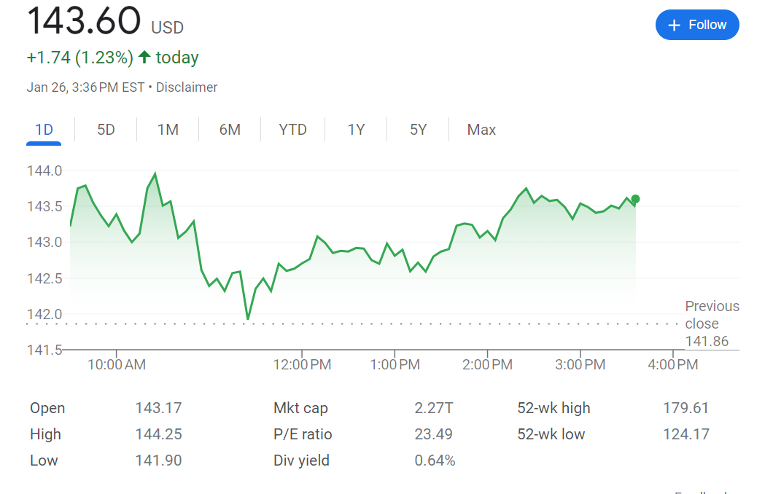
What is a Dividend

Slide 17
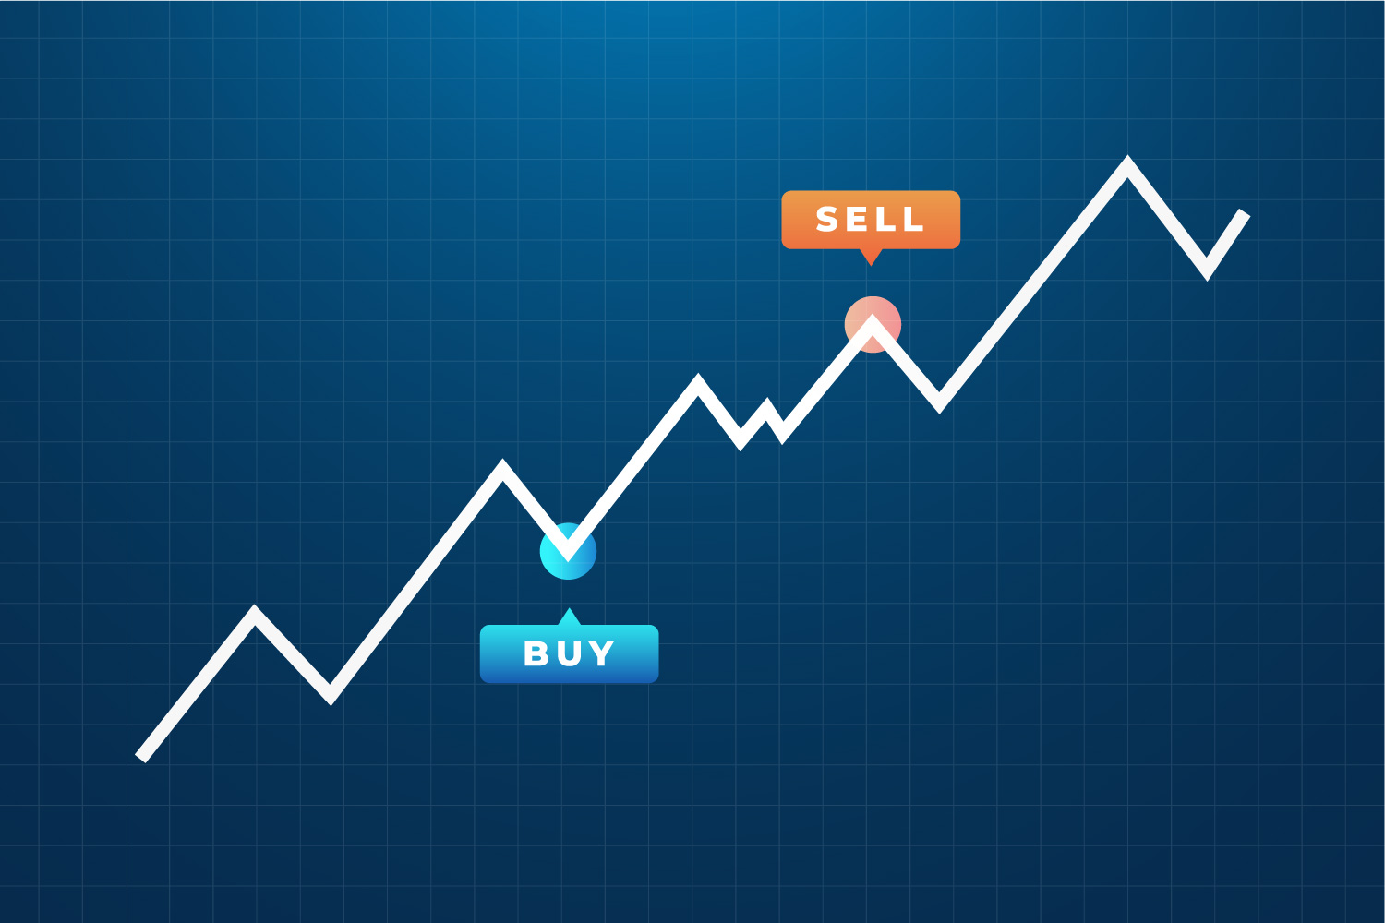
Leetcode Question (Best Time to Buy and Sell a Stock)

Slide 18
Leetcode Question (Best Time to Buy and Sell a Stock)
Pretty simple question
Now let’s do our own manipulation of the question where we want to find our max profit we can earn throughout the array

Slide 19
Quick Break!

Slide 20
What does it mean to short a stock
If you think a stock is going to go down you can actually invest your money into that scenario
Way more risky since you can lose more money then you bet
Dives into what options trading is
Essential component for pairs trading
Long traders may use shorting as a means to hedge a position
“Borrowing” shares of the stock and then sells these shares to buyers and then rebuy at a lower price

Slide 21
Shorting a stock can be very dangerous!!!
Just look at what happened with Gamestop

Slide 22
What is pairs trading?
A trading strategy that tries to find two companies or funds that share similar characteristics
Also the stocks need to be trading outside of their historical trading range
Long the undervalued stock
Short the overvalued stock
Hope they converge in the middle

Slide 23
Sources
https://www.investopedia.com/articles/bonds/09/bond-market-interest-rates.asp

